Slide 1
MICRO CREDIT DEFAULTER MODEL
BY
V TARAK RAM SAI

Slide 2
PROBLEM STATEMENT
This is regarding a telecom industry collaborating with Microfinance institution to provide micro-credit on mobile balances to be paid back in 5days.
We need to develop a model which can be used to predict in terms of a probability for each loan transaction, whether the customer is paying back the loaned amount within 5 days of insurance of loan.
In order to improve the selection of customers for the credit, the client wants some predictions that could help them in further investment and improvement in selection of customers.

Slide 3
Data Description
label | Flag indicating whether the user paid back the credit amount within 5 days of issuing the loan{1:success, 0:failure}
msisdn | mobile number of user
aon | age on cellular network in days
daily_decr30 | Daily amount spent from main account, averaged over last 30 days (in Indonesian Rupiah)
daily_decr90 | Daily amount spent from main account, averaged over last 90 days (in Indonesian Rupiah)
rental30 | Average main account balance over last 30 days
rental90 | Average main account balance over last 90 days
last_rech_date_ma | Number of days till last recharge of main account
last_rech_date_da | Number of days till last recharge of data account
last_rech_amt_ma | Amount of last recharge of main account (in Indonesian Rupiah)
cnt_ma_rech30 | Number of times main account got recharged in last 30 days
fr_ma_rech30 | Frequency of main account recharged in last 30 days
sumamnt_ma_rech30 | Total amount of recharge in main account over last 30 days (in Indonesian Rupiah)
medianamnt_ma_rech30 | Median of amount of recharges done in main account over last 30 days at user level (in Indonesian Rupiah)
medianmarechprebal30 | Median of main account balance just before recharge in last 30 days at user level (in Indonesian Rupiah)

Slide 4
Data Description
cnt_ma_rech90 | Number of times main account got recharged in last 90 days
fr_ma_rech90 | Frequency of main account recharged in last 90 days
sumamnt_ma_rech90 | Total amount of recharge in main account over last 90 days (in Indonasian Rupiah)
medianamnt_ma_rech90 | Median of amount of recharges done in main account over last 90 days at user level (in Indonasian Rupiah)
medianmarechprebal90 | Median of main account balance just before recharge in last 90 days at user level (in Indonasian Rupiah)
cnt_da_rech30 | Number of times data account got recharged in last 30 days
fr_da_rech30 | Frequency of data account recharged in last 30 days
cnt_da_rech90 | Number of times data account got recharged in last 90 days
fr_da_rech90 | Frequency of data account recharged in last 90 days
cnt_loans30 | Number of loans taken by user in last 30 days
amnt_loans30 | Total amount of loans taken by user in last 30 days
maxamnt_loans30 | maximum amount of loan taken by the user in last 30 days
medianamnt_loans30 | Median of amounts of loan taken by the user in last 30 days
cnt_loans90 | Number of loans taken by user in last 90 days
amnt_loans90 | Total amount of loans taken by user in last 90 days
maxamnt_loans90 | maximum amount of loan taken by the user in last 90 days
medianamnt_loans90 | Median of amounts of loan taken by the user in last 90 days
payback30 | Average payback time in days over last 30 days
payback90 | Average payback time in days over last 90 days
pcircle | telecom circle

Slide 5
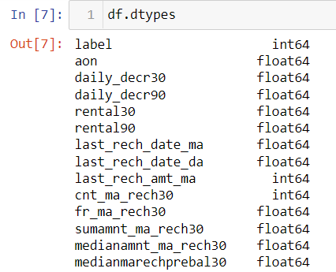
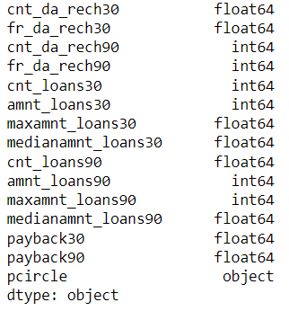
Data Description

Slide 6
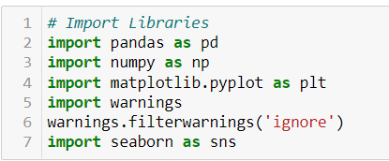
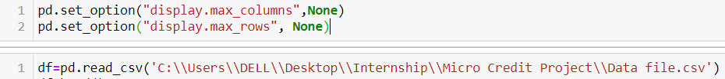
Data Pre-Processing
It entails converting raw data into comprehensible format that a machine learning model can understand. The data pre-processing involves data cleaning which involves handling missing values, transformation of data i.e. normalizing the data and data reduction which involves only required features.

Slide 7
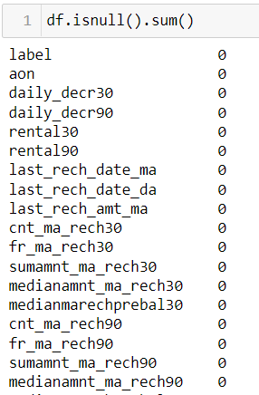
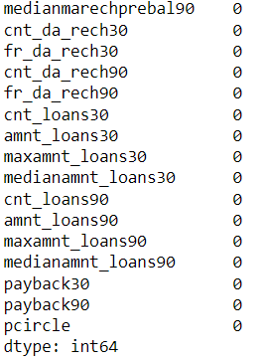
Data Cleaning
The first step of pre-processing is data cleaning by checking and eliminating any missing values because they affect the accuracy of the model. This is achieved by either filling the missing values with a mean or mode function or by dropping all the missing values. In this case, there are no missing values.

Slide 8
Data Reduction
The next step of data processing is data reduction. This is used to remove duplicate features present in the data i.e. unwanted features for prediction.

Slide 9
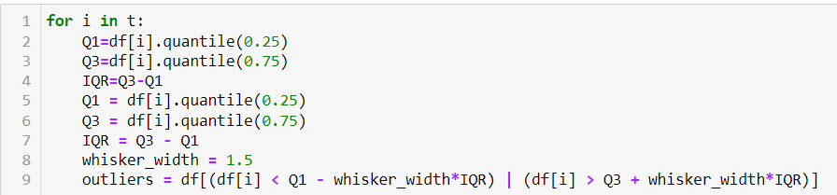
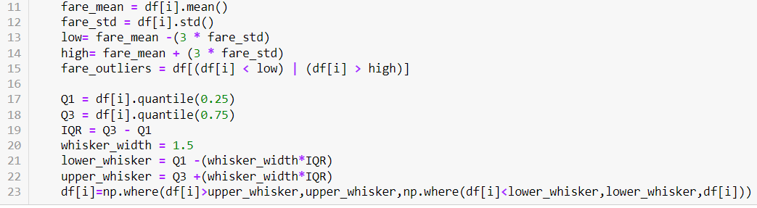
Handling Outliers
Instead of eliminating the outliers, we have replaced the outliers higher than the upper whisker by the value of upper whisker and the outliers lower than the lower whisker by the value of lower whisker.

Slide 10
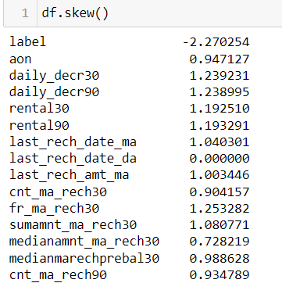
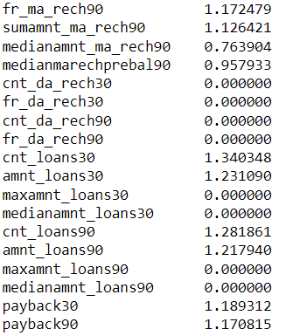
Skewness Removal
We have to remove the skewness from the columns whose skewness is not in the range of -0.5 to +0.5. Here, we are using a power transformer to remove the skewness as follows:

Slide 11
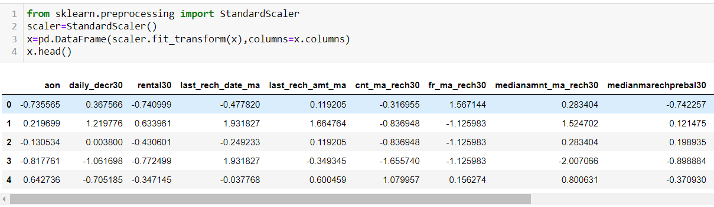
Scaling
Feature scaling is a method used to normalize the range of independent variables or features of data. To convert data into a distribution with a mean of 0 and standard deviation of 1, we will use a standard scalar.

Slide 12
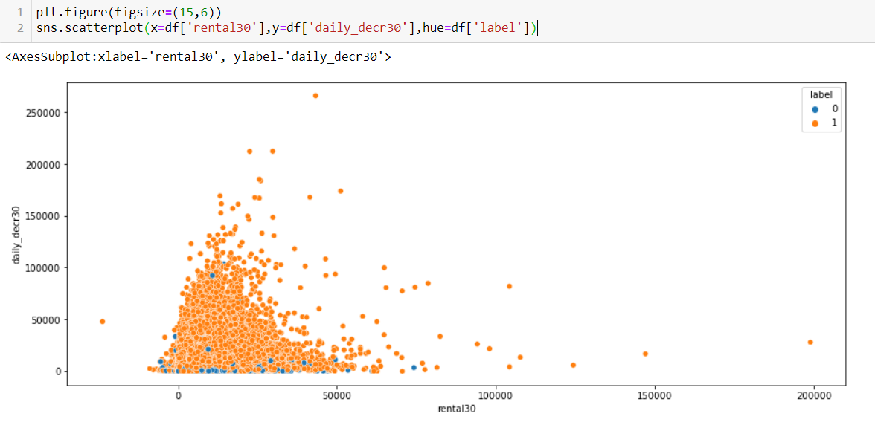
Data Inputs- Logic- Output Visualization
The average main account balance is mostly in between 0 and 50000. Daily amount spent from main account, averaged over last 30 days is mostly between 0 and 100000.

Slide 13
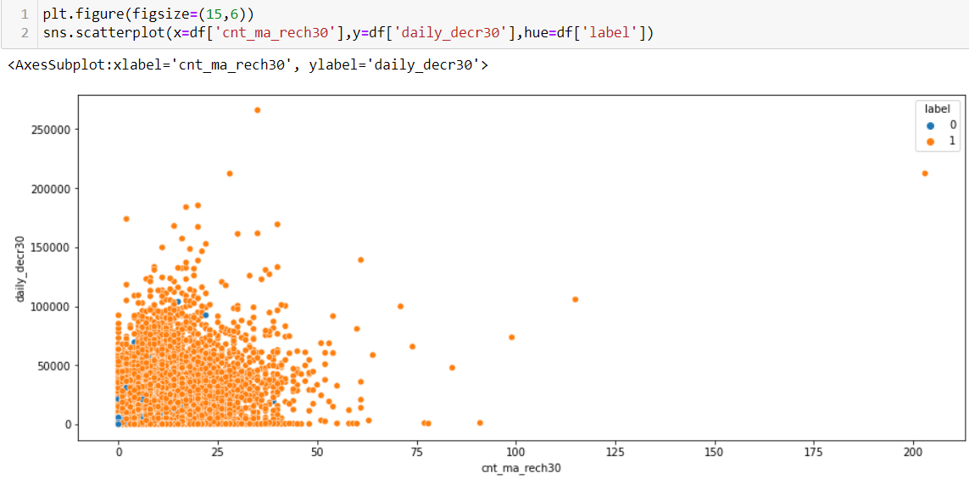
Data Inputs- Logic- Output Visualization
Number of times main account got recharged in last 30 days is mostly between 0 and 40, If the no. of times the customer recharged is more, then the customer is a non-defaulter.

Slide 14
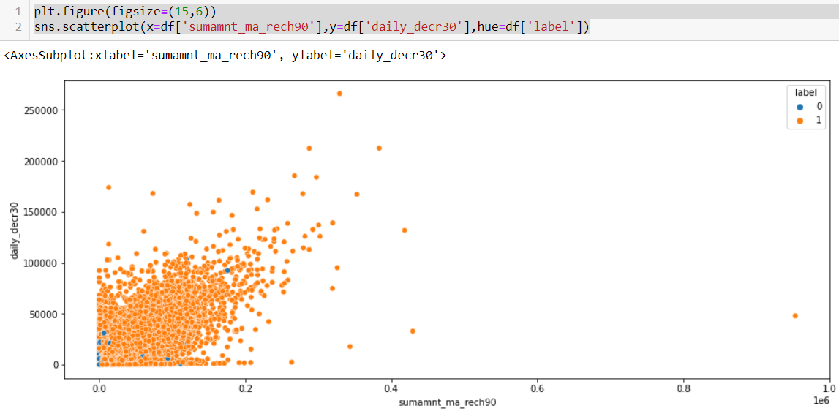
Data Inputs- Logic- Output Visualization
Total amount of recharge in main account over last 90 days is positively related to daily_decr30.

Slide 15
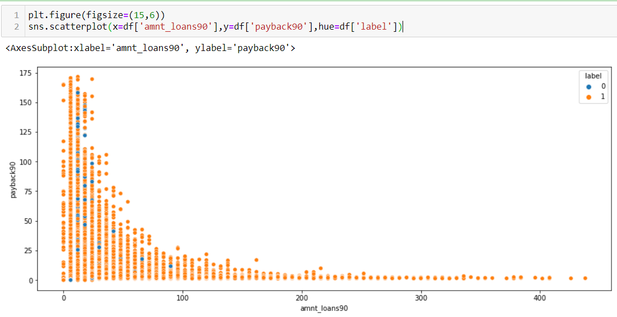
Data Inputs- Logic- Output Visualization
If the Total amount of loans taken by user in last 90 days is more than the Average payback time in days over last 90 days is less.

Slide 16

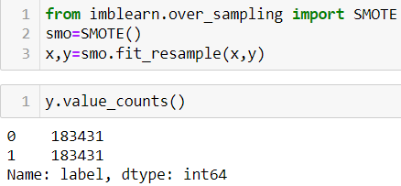
Model/s Development and Evaluation
The independent variables are declared in x and the dependent variable i.e. ‘label’ is declared in y as follows
Now sampling should be done, in order to eliminate priority on the output variable by the model.

Slide 17
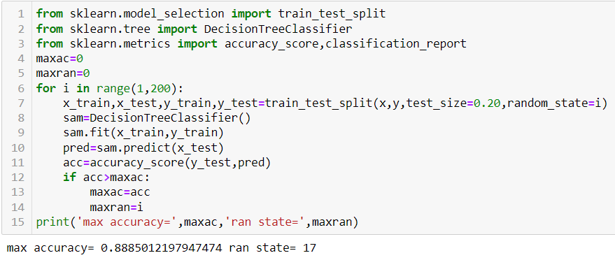
Choosing Random Variable
The below code is done for choosing the Random state variable. We should do testing by using any of the four classification algorithms.

Slide 18
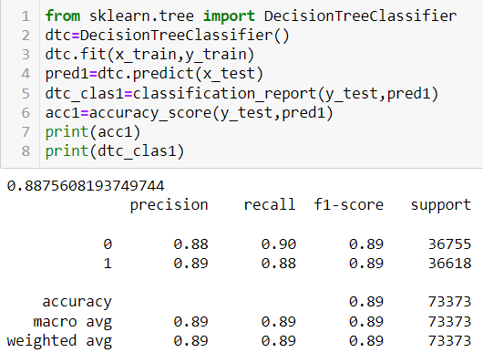
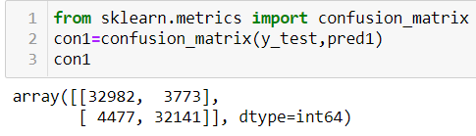
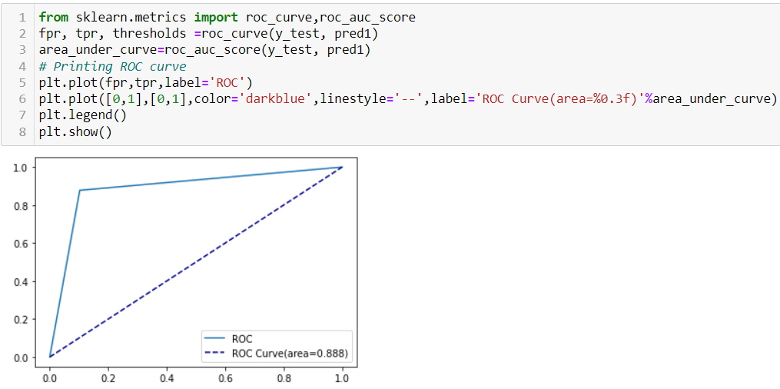
Decision Tree Classifier

Slide 19
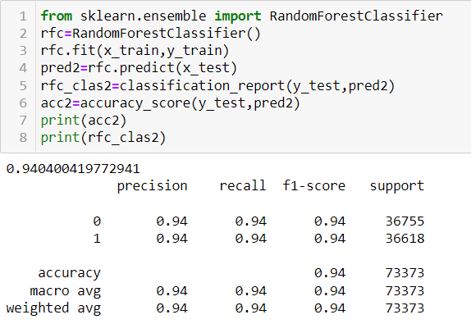
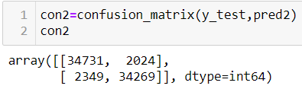
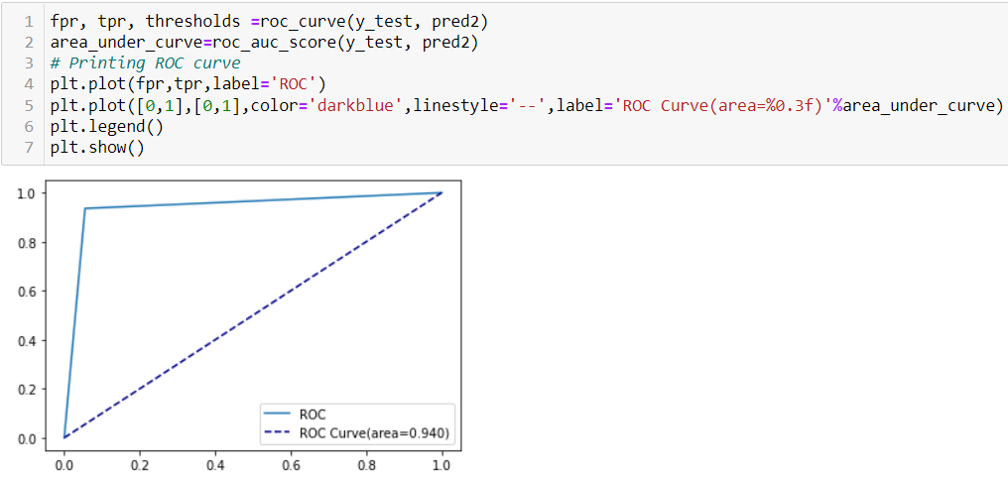
Random Forest Classifier

Slide 20
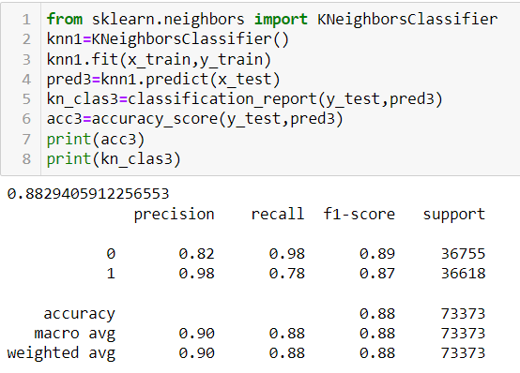
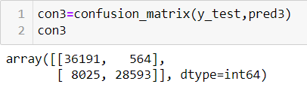
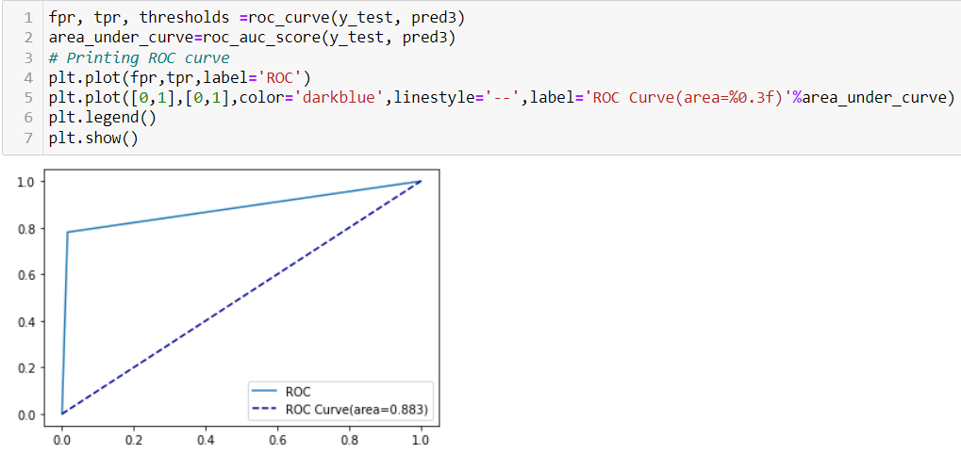
KNN Classifier

Slide 21
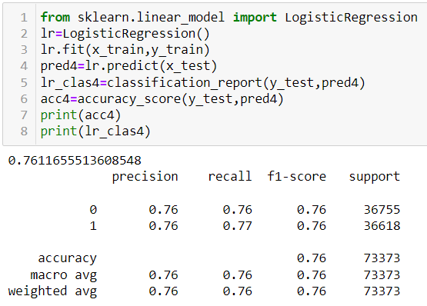
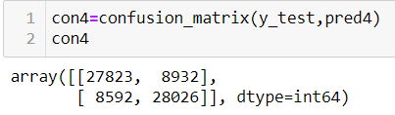
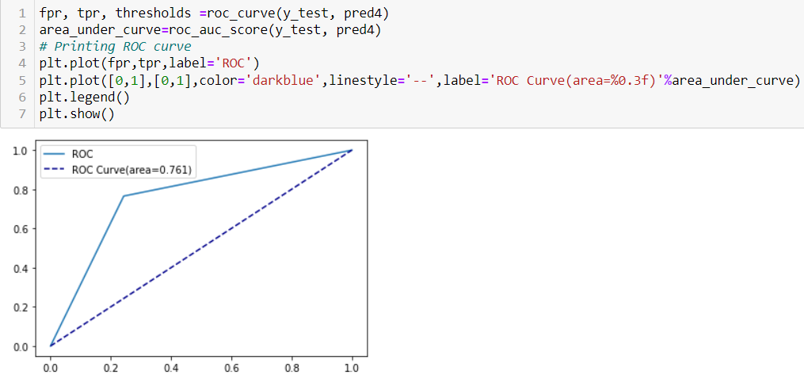
Logistic Regression

Slide 22
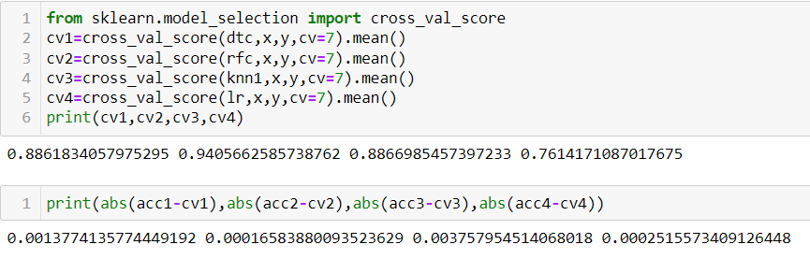
Cross Validation
Cross Validation is a very useful technique for assessing the effectiveness of your model, particularly in cases where you need to mitigate overfitting.
We can choose Random Forest as our model since its cv_score and accuracy score are almost similar.

Slide 23
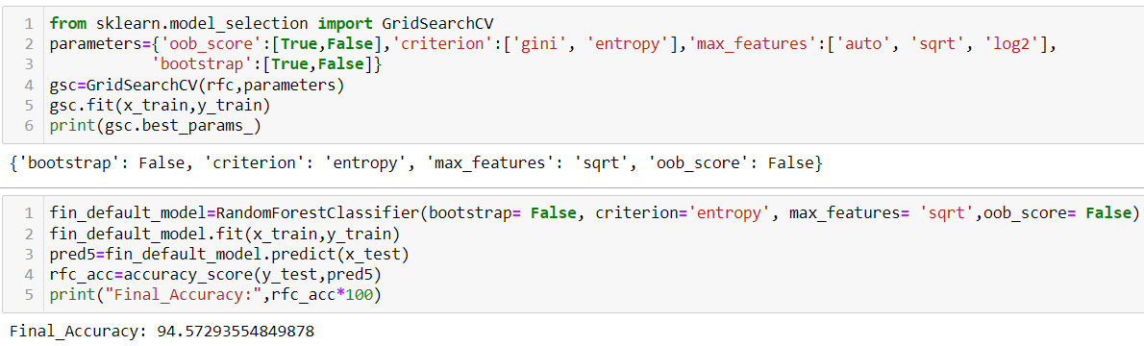
Hyper Parameter Tuning
In machine learning, hyper parameter optimization or tuning is the problem of choosing a set of optimal hyper parameters for a learning algorithm. A hyper parameter is a parameter whose value is used to control the learning process. By contrast, the values of other parameters (typically node weights) are learned.

Slide 24
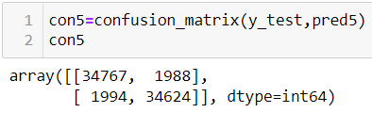
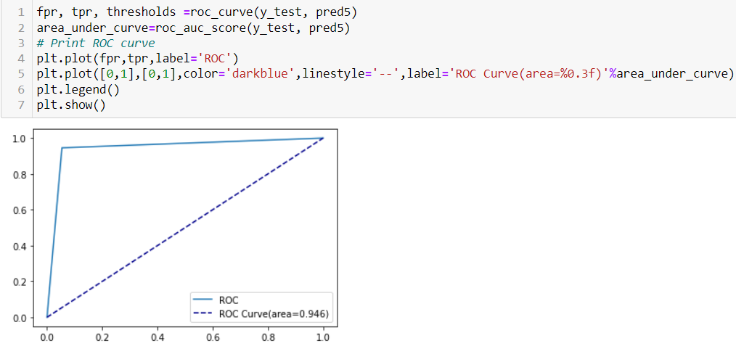
Evaluation of Final Model
The right diagonal elements in the confusion matrix shows the correctly predicted values by the model.
Higher the area under the curve, better the performance of the model. By performing Hyper Parameter Tuning, we managed to increase the performance of the model.

Slide 25
Conclusion
The applications of machine learning techniques in the financial sector with the goal of profit maximization has seen a rising interest over the last few years. There has been increasing number of research conducted in the areas of credit scoring, risk management and bankruptcy prediction using machine learning approaches.
This research proposes machine learning as a method to improve the accuracy of loan default predictions. This better understanding of customer behaviours to improve the prediction of loan default will contribute to tremendous financial benefit in the mobile lending sector.
Exploratory data analysis shows the correlation of various features with loan default to select the most appropriate features to train the machine learning model. The train and test set are then applied to four machine learning algorithms to determine the one with most accurate results. Key performance metrics which include confusion matrix, accuracy, precision and recall are applied to evaluate the best learning technique in loan defaulter prediction.

Slide 26
Limitations of this work and Scope for Future Work
Machine Learning algorithms are limited to the dataset used to train and test the model. This limits the generalization of the model as it specifies towards the dataset used to train and test the model. It would be beneficial to look comprehensively at the main features that are relevant to the characteristic that drive default and can be applied.
This research explores using machine learning algorithms to improve the accuracy of predicting loan default. This is a fair performance and can be further improved through different methods of parameter tuning and feature selection which may possibly yield improvements in the model performance. Since, the research is also limited to the probability of default state, further exploration may be made in determining the expected return of the loan based on borrower’s characteristics.

